Slide 1
INTRODUCTION
TEAM MEMBER 1. Deepanshu
2. Hemant 3. Krishan 4. Sanket Jindal 5. Uday Yadav

Slide 2
CONTENT
01
02
03
04 05
Key Features
Data Types
Operators
Variables
Inheritance

Slide 3
Key Features
Simple : Java has a straightforward and clean syntax,
Making it easy to learn and understand.
Object Oriented : Everything in Java is an object. OOP concepts include inheritance,
polymorphism, abstraction,
and encapsulation.

Slide 4
Key Features
Portable and Platform Independent : Java follows the “write once, run anywhere” (WORA) principle.
Secured : Java is known for its security features.
Multithreaded : Java supports multithreading, allowing concurrent execution of tasks.

Slide 5
Data Types
Data types are mainly of two type:-
1. Primitive : These are the most basic data types.
2.Non-Primitive : These include user- defined data types (classes, interfaces, arrays).

Slide 6
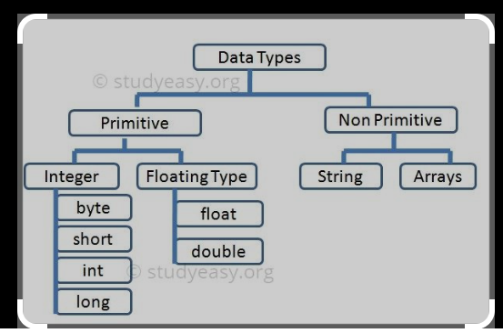

Slide 7
Operators 1. Arithmetic Operators : These operators perform simple arithmetic operations on primitive data types: + : Addition - : Subtraction * : Multiplication / : Division %: Modulo (remainder) 2. Unary Operators : - : Unary minus (negates the value) + : Unary plus (indicates positive value) ++: Increment operator (post-increment and pre-increment) -- : Decrement operator (post-decrement and pre-decrement) ! : Logical not operator (inverts a boolean value)

Slide 8
Operators
3. Assignment Operator : The assignment operator (=) assigns a value to a variable
4. Relational Operators : These operators compare values:
== : Equal to
!= : Not equal to
> : Greater than
< : Less than
>= : Greater than or equal to
<= : Less than or equal to
5. Logical Operators : These operators perform logical operations:
&& : Logical AND
|| : Logical OR
! : Logical NOT

Slide 9
Operators 6. Bitwise Operators: These operators manipulate individual bits: & : Bitwise AND | : Bitwise OR ^ : Bitwise XOR ~ : Bitwise NOT << : Left shift >> : Right shift >>> : Unsigned right shift
7. Ternary Operator:
The ternary operator (? :) is a shorthand for an if-else statement.

Slide 10
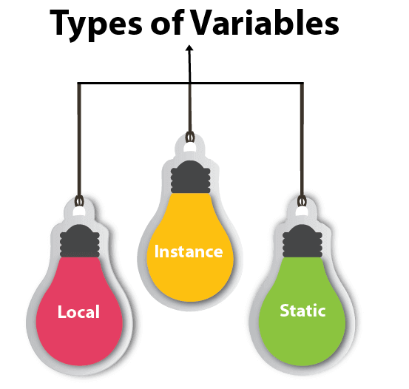
Variables A variable is a named storage location within a program where data can be stored and manipulated. There are 3 types of variables in Java: Local Variable: Declared inside a method. Limited to the method’s scope. Not visible outside the method.

Slide 11
Variables Instance Variable: Declared within a class but outside any method. Associated with an instance (object) of the class. Not declared as static. Static Variable: Declared with the static keyword. Shared among all instances of the class. Memory allocated once when the class is loaded.

Slide 12
Inheritance In Java, inheritance is a fundamental concept in Object-Oriented Programming (OOP) . There are 5 type of inheritance : 1. Single inheritance : In single inheritance, a subclass can extend only one superclass. 2. Multilevel inheritance : When multiple classes are involved, forming a parent-child relationship in a linear chain, we call it multilevel inheritance.

Slide 13
inheritance 3. Hierarchical inheritance : when multiple child classes inherit properties and methods from a single parent class 4. Hybrid inheritance : In Java, the hybrid inheritance is the composition of two or more types of inheritance. 5. Multiple inheritance : Java does not support multiple inheritance with classes but we can achieve multiple inheritances only through Interfaces.

Slide 14
THANK YOU

